Slide 1
CSE322
Mealy and Moore Machine
Lecture #4

Slide 2
Null Transition
An NFA with null transition is allowed to make transition not only on input from the alphabet but also with null input, i.e. without any input symbol. This transition without input is called null transition.

Slide 3
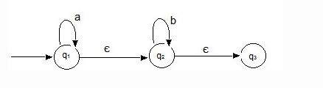
Null Transition

Slide 4
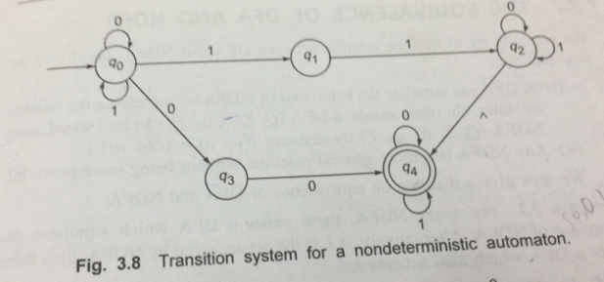
Null Transition

Slide 5
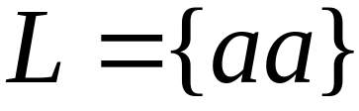


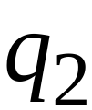


Language accepted:

Slide 6


Lambda Transitions

Slide 9
(read head does not move)

Slide 11

all input is consumed
“accept”
String is accepted

Slide 12
Rejection Example

Slide 14
(read head doesn’t move)

Slide 15
No transition:
the automaton hangs

Slide 16

Input cannot be consumed
“reject”
String is rejected

Slide 17
Language accepted:

Slide 18


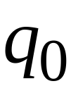
Another NFA Example

Slide 19
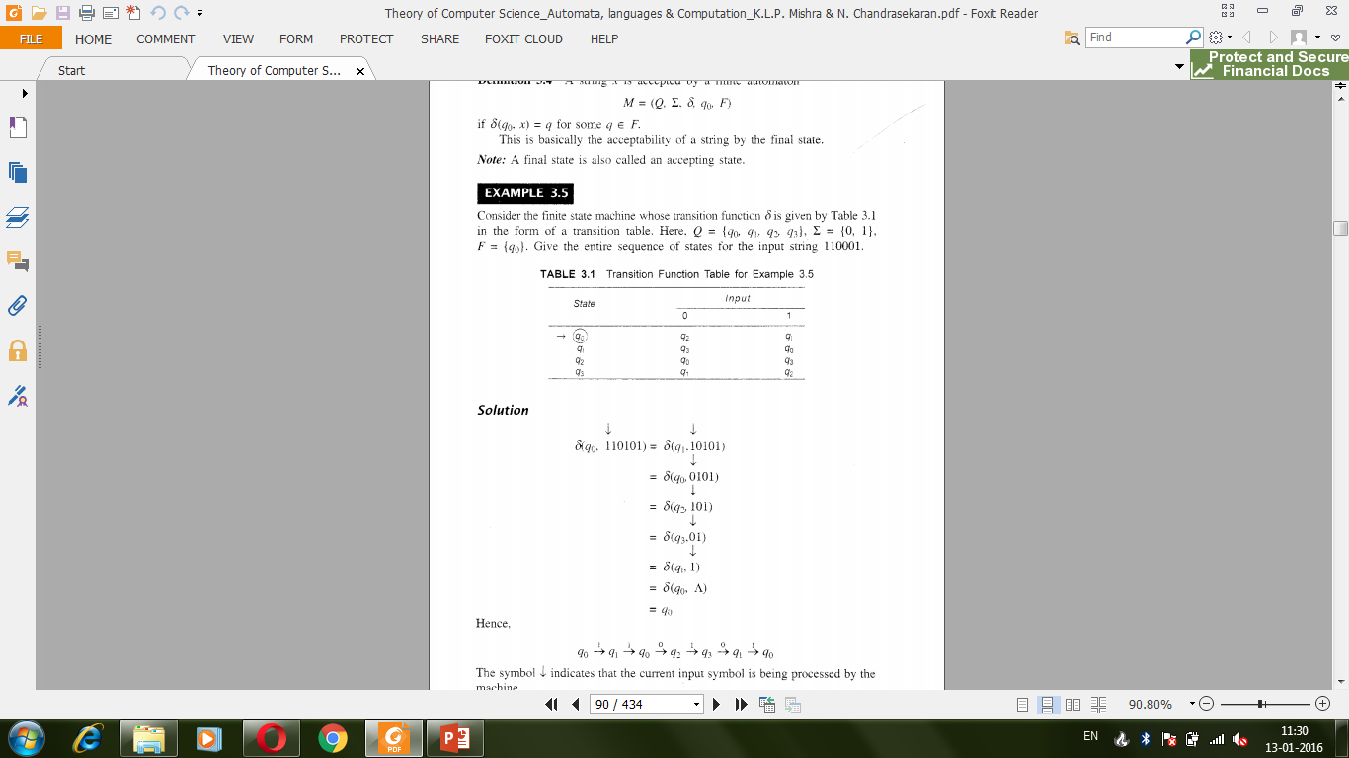
How to accept a string

Slide 20
How to accept a string

Slide 21


Slide 24
“accept”

Slide 25
Another String

Slide 32
“accept”

Slide 33
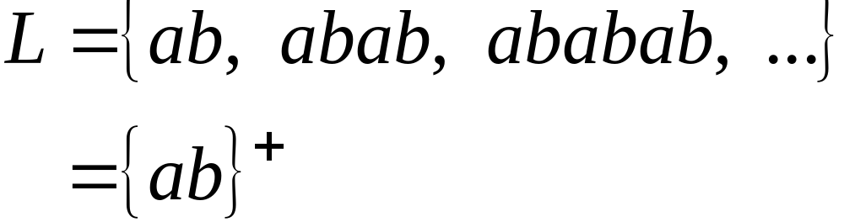
Language accepted

Slide 34

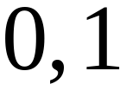

Another NFA Example

Slide 35
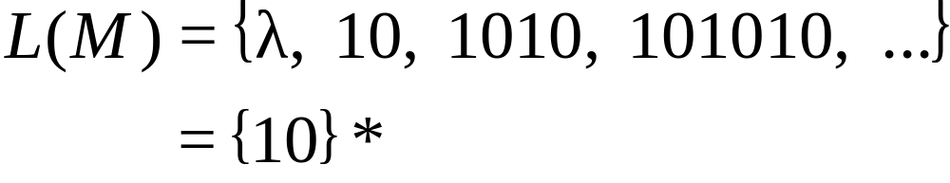
Language accepted
(redundant
state)

Slide 36
Mealy and Moore Model
In finite Automata acceptability was decided on the basis of reach ability of the final state by initial state.
This restriction are removed and new model is given in which output can be chosen from some other alphabet.
The value of the output function Z(t) is a function of present state q(t) and the present input x(t)
Z(t) = λ(q(t), x(t)) Mealy Machine
The value of the output function Z(t) is a function of present state q(t) only and is independent of the current input
Z(t) = λ(q(t)) Moore Machine
Notes:
Mealy and Moore Model

Slide 37
Moore Machine
Moore Machine is six-tuple (Q,∑,∆,δ,λ,q₀):
Q is a finite set of states
∑ is the input alphabet
∆ is the output alphabet
δ is the transition function from ∑ X Q into Q
λ is the output function mapping Q into ∆ and
q₀ is the initial state
Notes:
Mealy and Moore Model

Slide 38
Mealy Machine
Mealy Machine is six-tuple (Q,∑,∆,δ,λ,q₀):
Q is a finite set of states
∑ is the input alphabet
∆ is the output alphabet
δ is the transition function from ∑ X Q into Q
λ is the output function mapping ∑ X Q into ∆ and
q₀ is the initial state
Notes:
Mealy and Moore Model

Slide 39
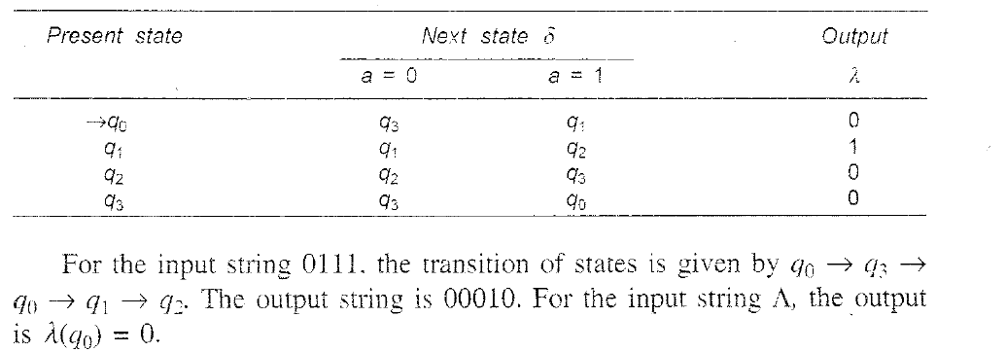
Example of Moore Machine
Notes:
Mealy and Moore Model

Slide 40

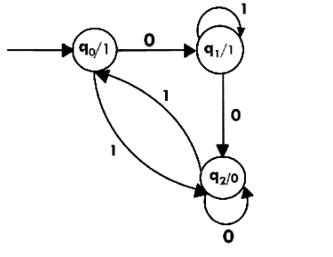
Moore Machine

Slide 41
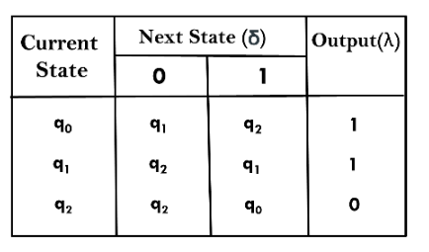

Slide 42
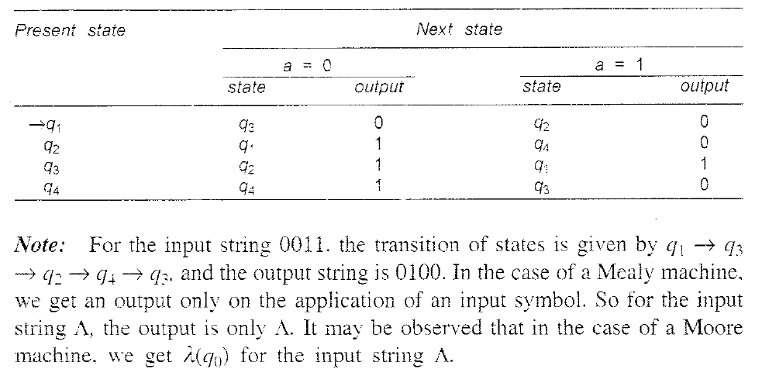
Example of Mealy Machine
Notes:
Mealy and Moore Model

Slide 43
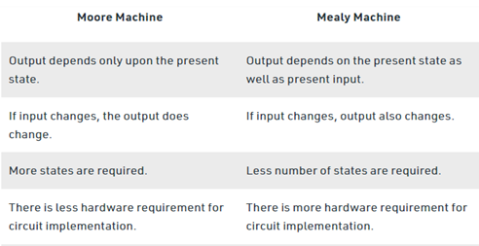
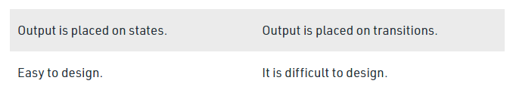

Slide 45
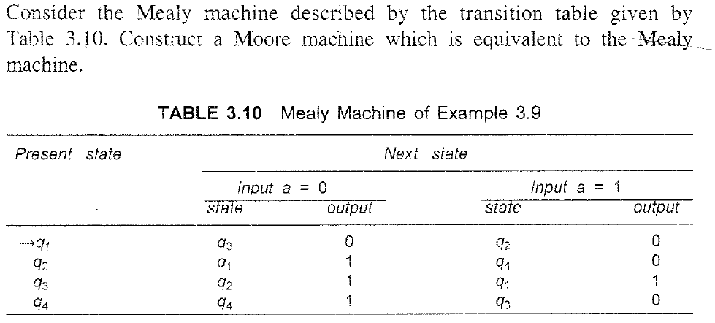
Transforming Mealy to Moore Machine
Notes:
Mealy and Moore Model

Slide 46
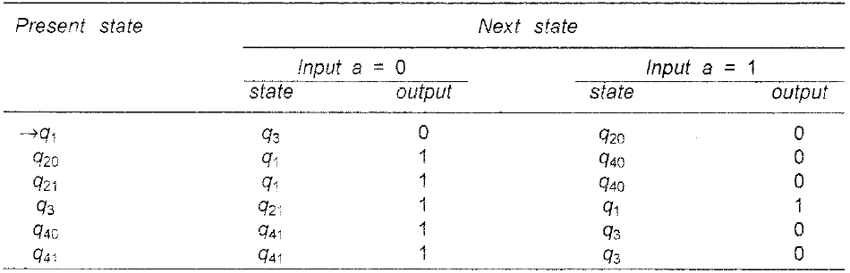
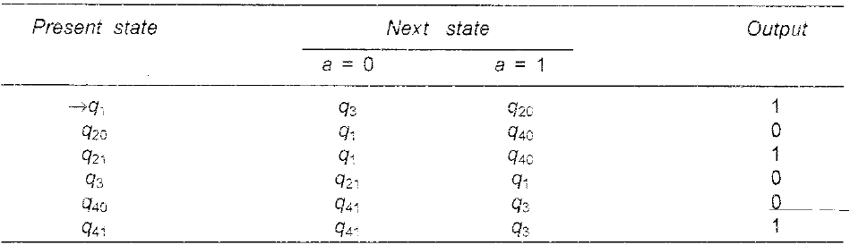
Solution
Notes:
Mealy and Moore Model

Slide 47
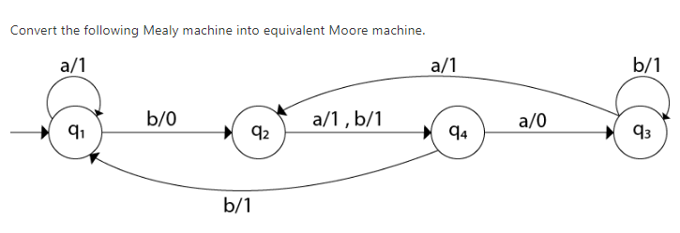

Slide 48
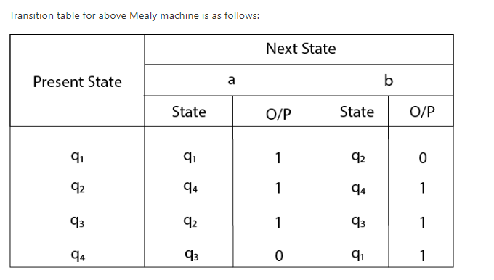

Slide 49
For state q1, there is only one incident edge with output 0. So, we don't need to split this state in Moore machine.
For state q2, there is 2 incident edge with output 0 and 1. So, we will split this state into two states q20( state with output 0) and q21(with output 1).
For state q3, there is 2 incident edge with output 0 and 1. So, we will split this state into two states q30( state with output 0) and q31( state with output 1).
For state q4, there is only one incident edge with output 0. So, we don't need to split this state in Moore machine.

Slide 50
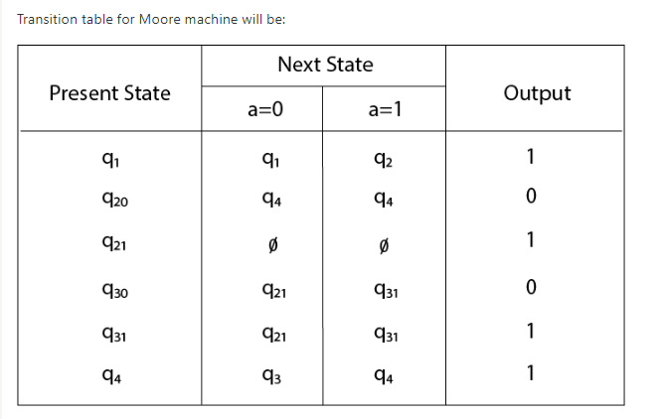

Slide 51
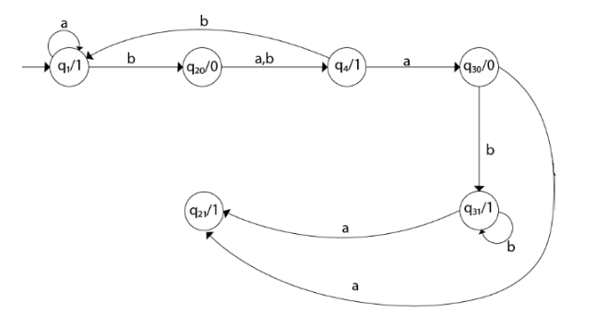

Slide 52
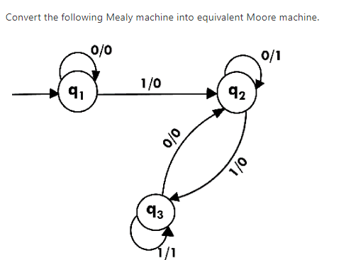

Slide 53
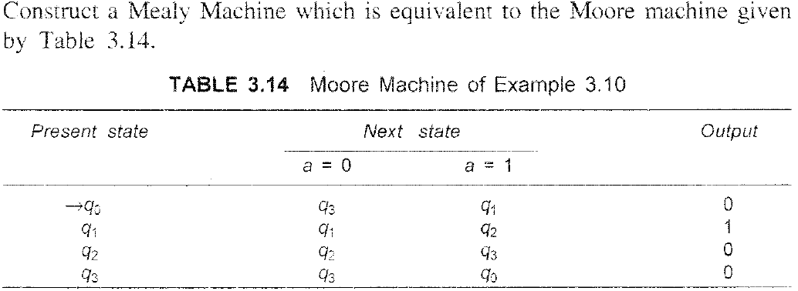
Transforming Moore to Mealy Machine
Notes:
Mealy and Moore Model

Slide 54
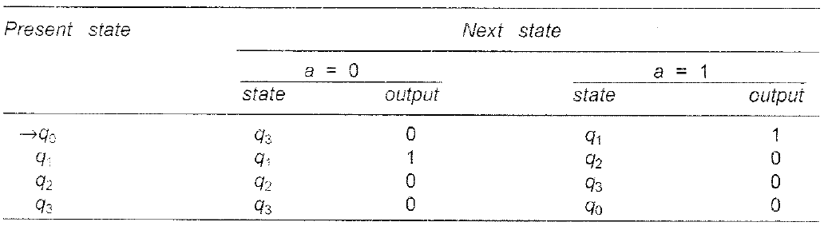
Solution
Notes:
Mealy and Moore Model

Slide 55
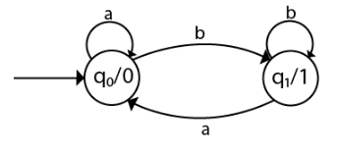
Moore to Mealy conversion

Slide 56
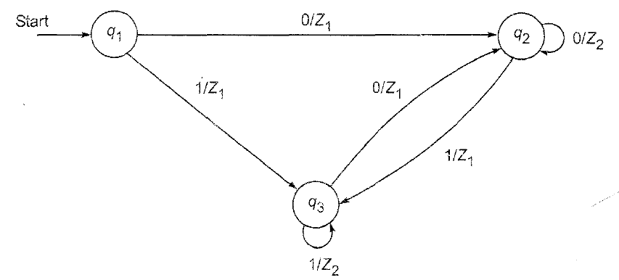

Slide 57
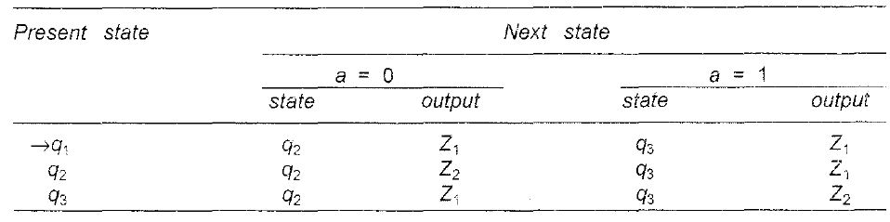
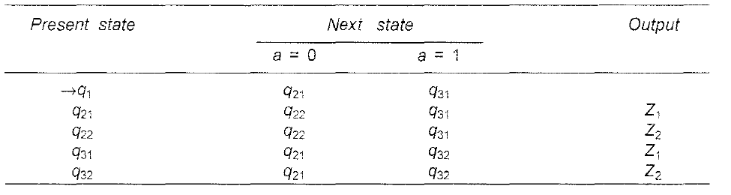
Solution
Notes:
Solution

Slide 58
Answer Justification
Here there is no output associated with q1 so, It will be ^.
q2 is associated with 2 outputs z1 and z2 so 2 states will be considered q21,q22.
q3 is associated with 2 outputs z1 and z2 so 2 states will be considered q31,q32

Slide 59
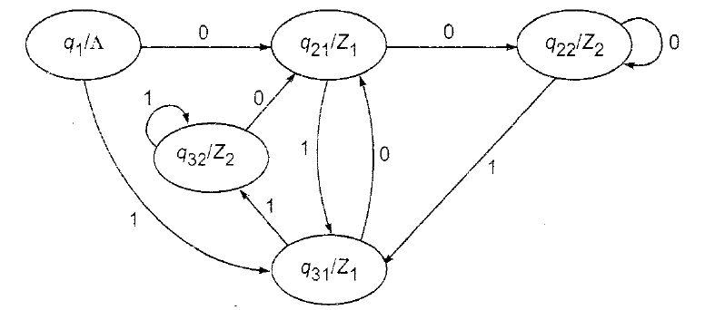
Answer

Slide 60
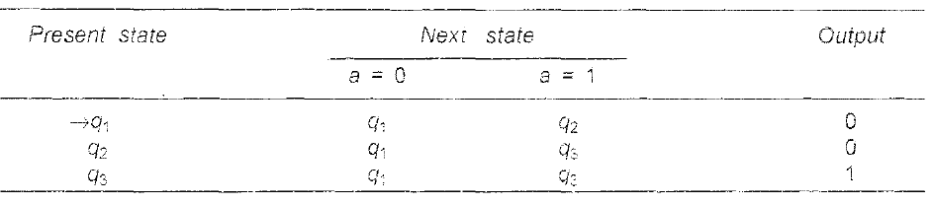

Slide 61
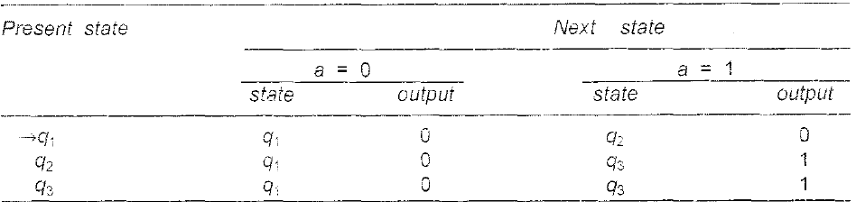
Solution
Notes:
Solution

Slide 62
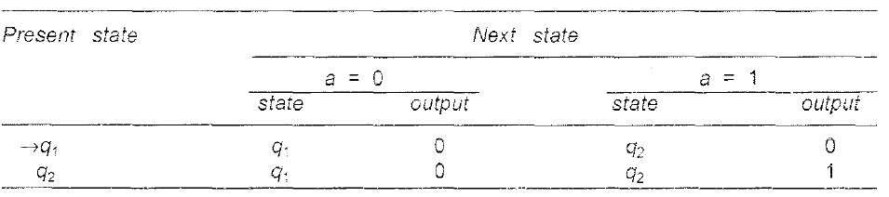
Convert it to Moore Machine

Slide 63
Convert it to mealy machine

